Slide 1

Quantile Regression
Ruibin Xi

Slide 2
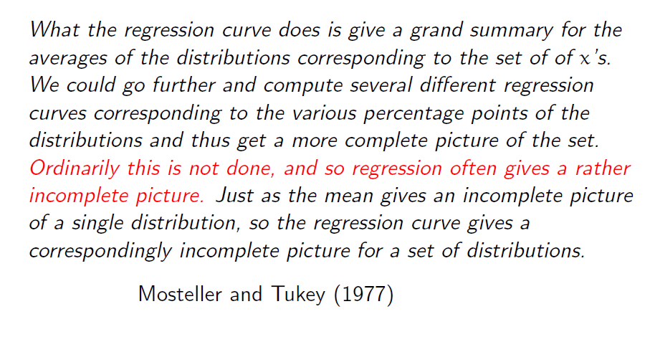
Motivation

Slide 3
Motivation
In linear model setup
response = signal + i.i.d. error (usually assume Gaussian error)
This is a rather simplified world
Quantile Regression is meant to expand the regression window to allow us see more.

Slide 4
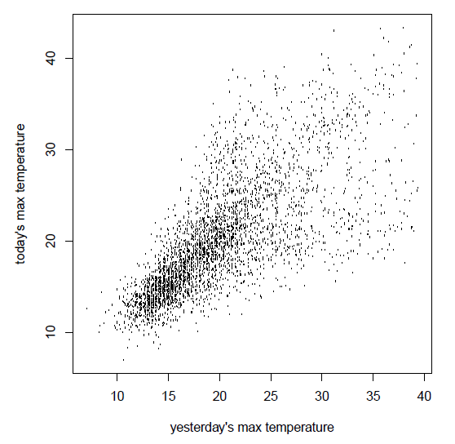
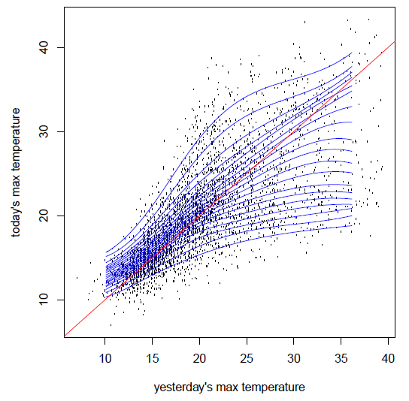
Motivation-A Real example
Daily temperature in Melbourne

Slide 5

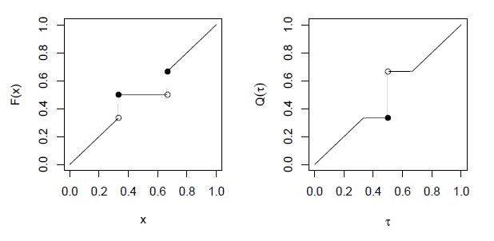
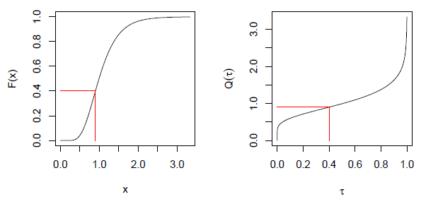
Univariate Quantile
Given a real-valued random variable, X, with distribution function F, we define the τth quantile of X as

Slide 6
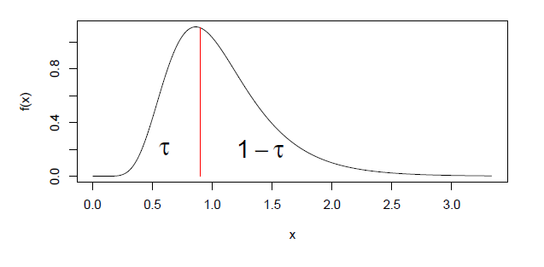
Univariate Quantile
Viewed from the perspective of densities, the τth quantile splits the area under the density into two parts: one with area τ below the τth quantile and the other with area 1- τ above it.

Slide 7
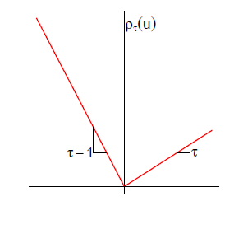


The Check function
We define a loss function
Note that if τ=0.5,
Quantiles solve a simple optimization problem

Slide 8
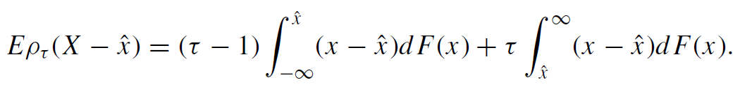
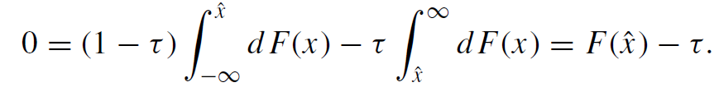

The Check function
We seek to minimize
Differentiating w.r.t. , we have

Slide 9
Mean-based regression
The unconditional mean solves
The conditional mean solves
If we assume , the above problem becomes solving
The sample version is

Slide 10
Quantile Regression
The unconditional quantile solves
The conditional quantile solves
Similarly, assume , we have the sample version of the problem

Slide 11
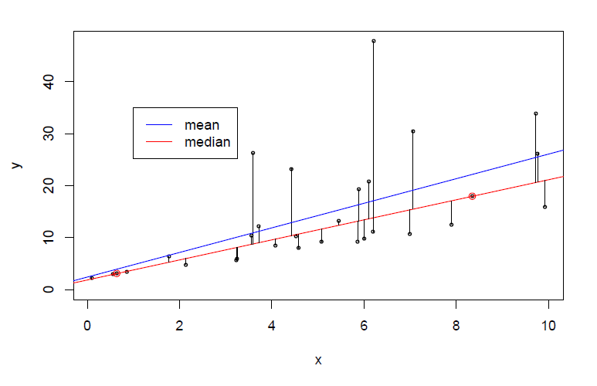
Conditional Mean V.S. Median

Slide 12
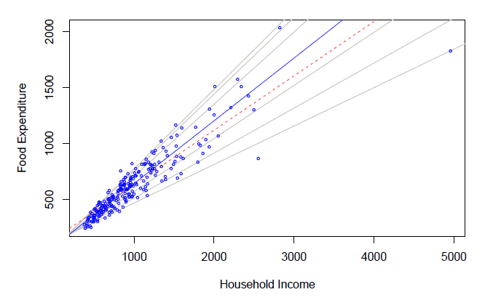
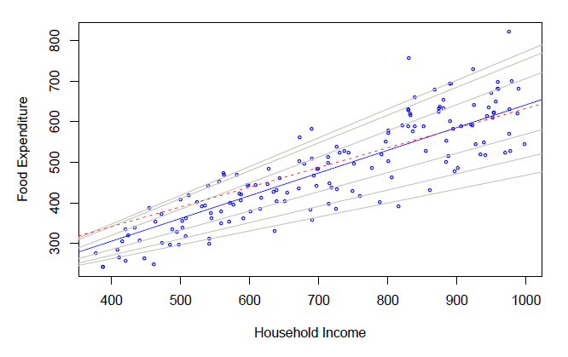
Engel’s Food Expenditure Data
Food Expenditure VS Household Income
Mean regression: red; Median: blue;
Others are quantiles 0.05, 0.1, 0.25, 0.75,
0.9, 0.95

Slide 13
A model of infant birth weight
Data: June, 1997, Detailed Natality Data of the US. Live, singleton births, with mothers recorded as either black or white, between 18-45, and residing in the U.S. Sample size: 198,377.
Response: Infant birth weight (in grams)
Covariates
Black or white (white as baseline)
Martial status (unmarried as baseline)
Mother’s Education (Less than high school as baseline)
Mother’s Prenatal care
Mother’s Smoking
Mother’s Age
Mother’s Weight Gain

Slide 14
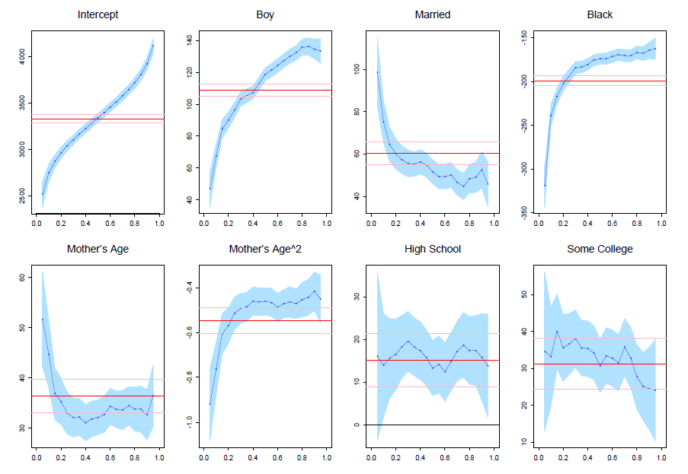
Birth weight QR model (1)

Slide 15
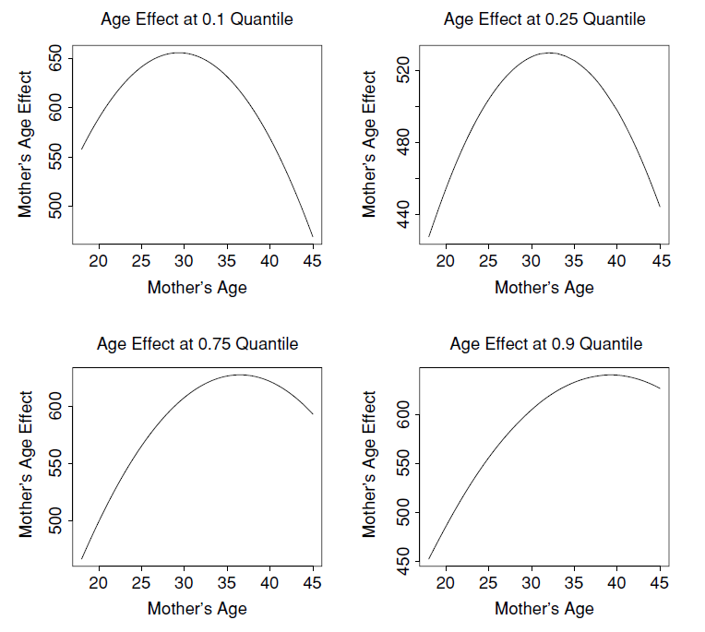
Mather’s Age effect

Slide 16
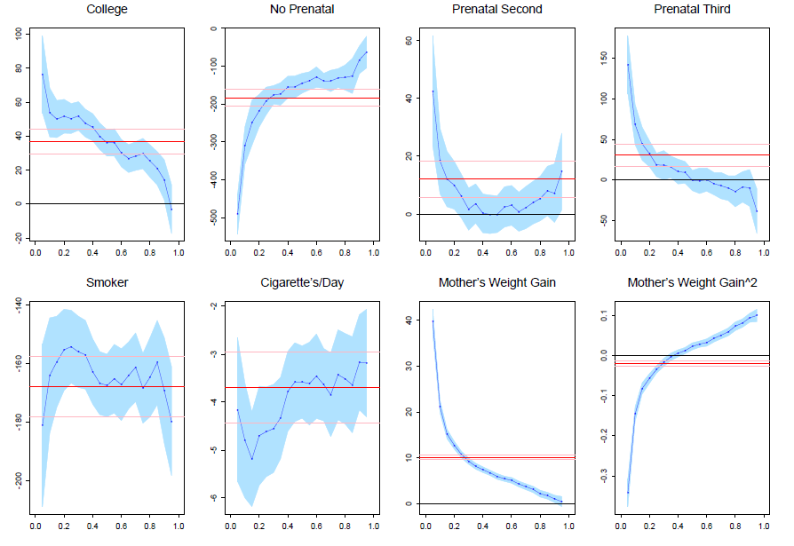
Birth weight QR model (2)

